Slide 1
10
Programmable Logic

Slide 2
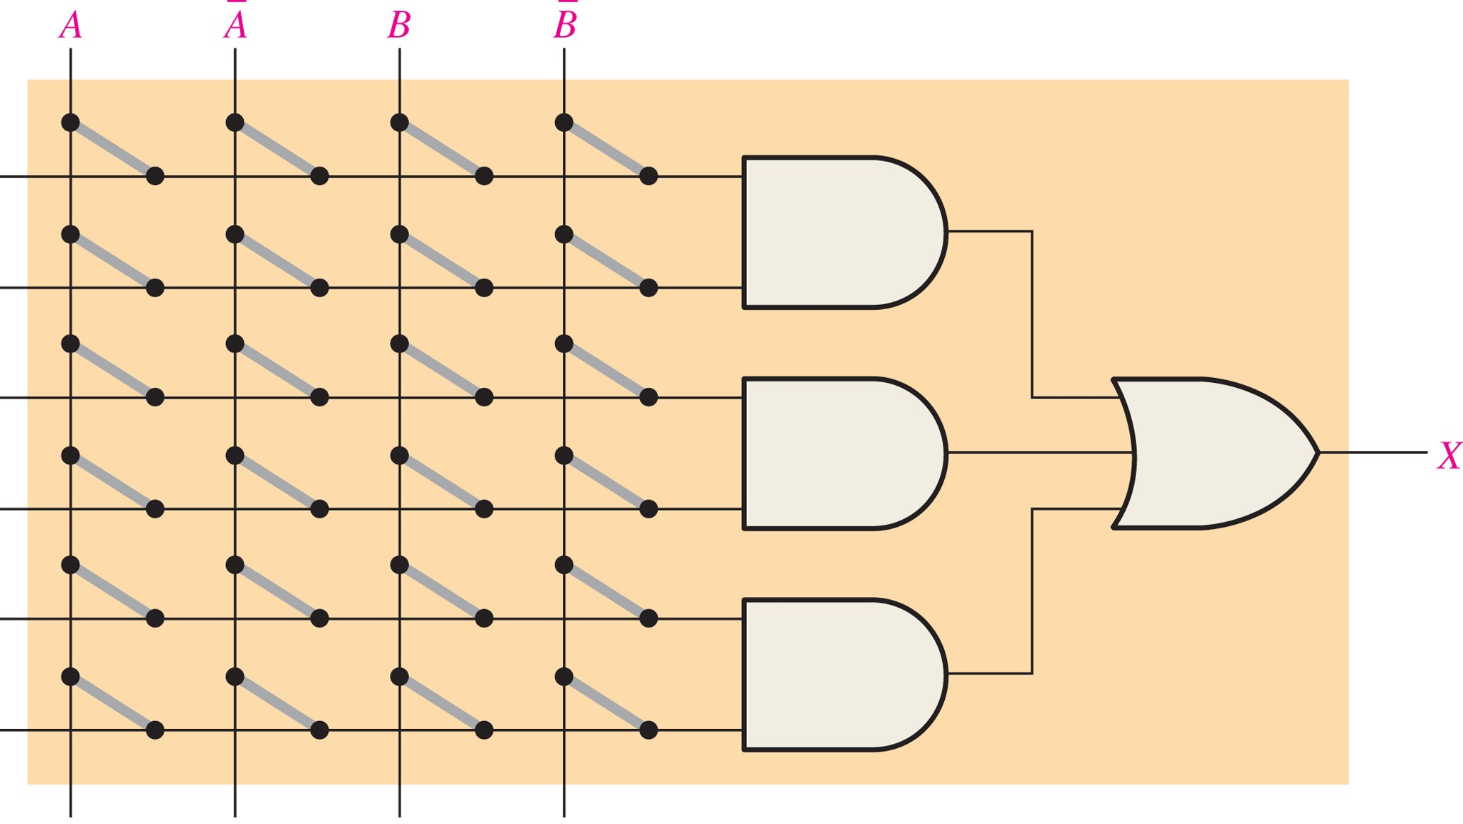
A PAL (programmable array logic) consists of a programmable array of AND gates that connects to a fixed array of OR gates

Slide 3
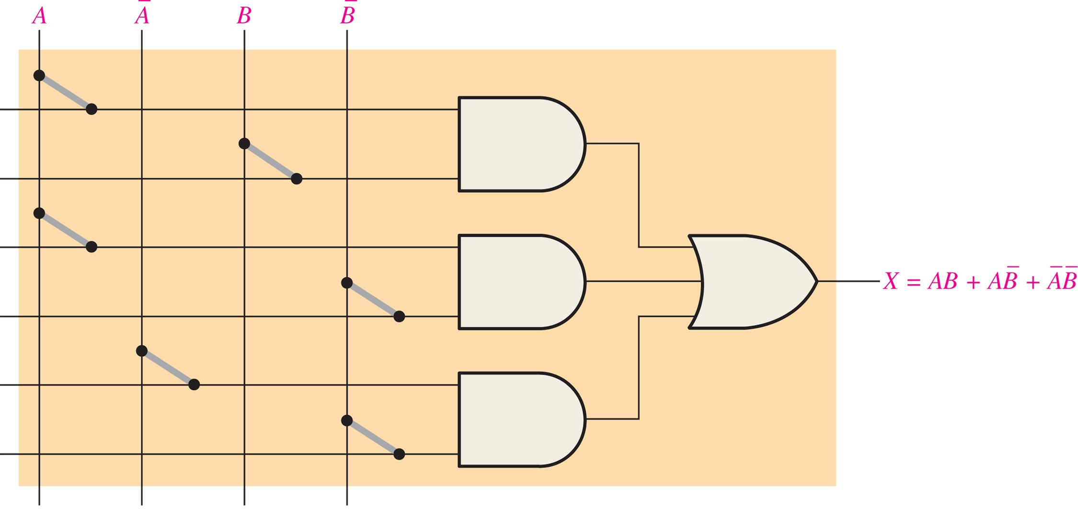
FIGURE 10-2 PAL implementation of a sum-of-products expression.

Slide 4
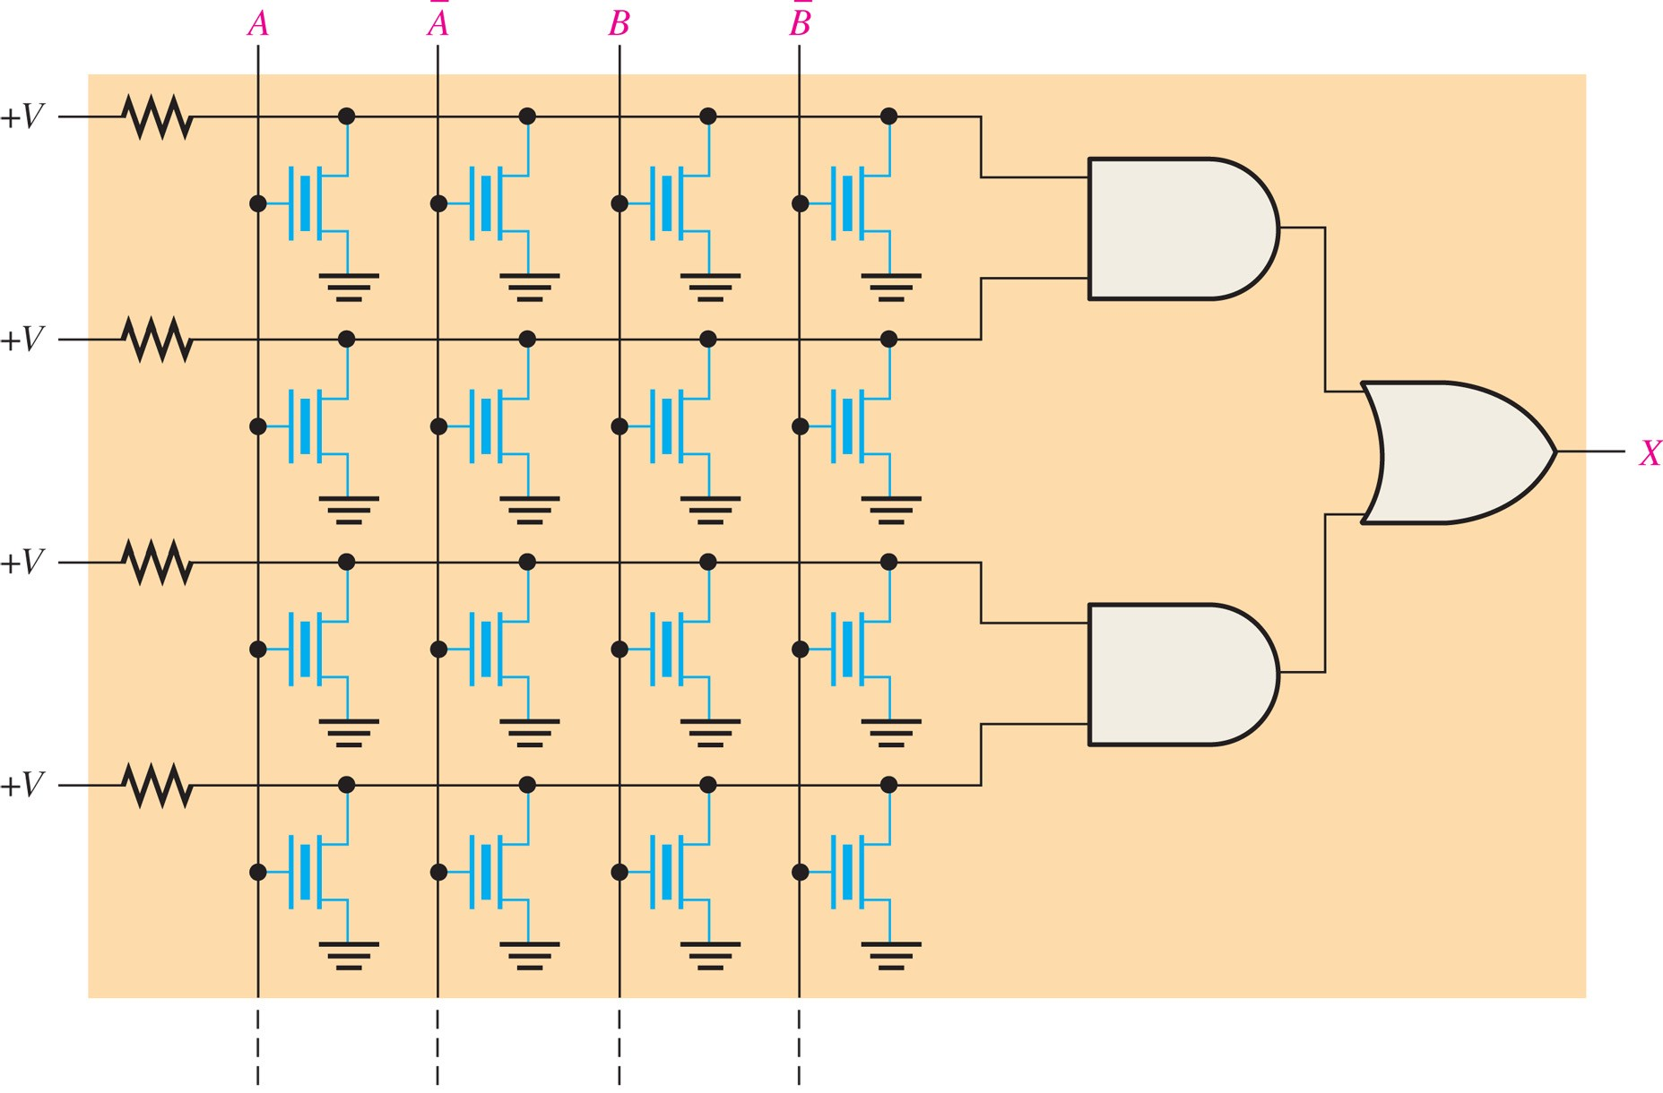
FIGURE 10-3 Simplified GAL array.
SPLD: The GAL The GAL is essentially a PAL that can be reprogrammed. It has the same type of AND/ OR organization that the PAL does. The basic difference is that a GAL uses a reprogrammable process technology, such as EEPROM (E2CMOS), instead of fuses, as shown in Figure 10–3. A A B

Slide 5
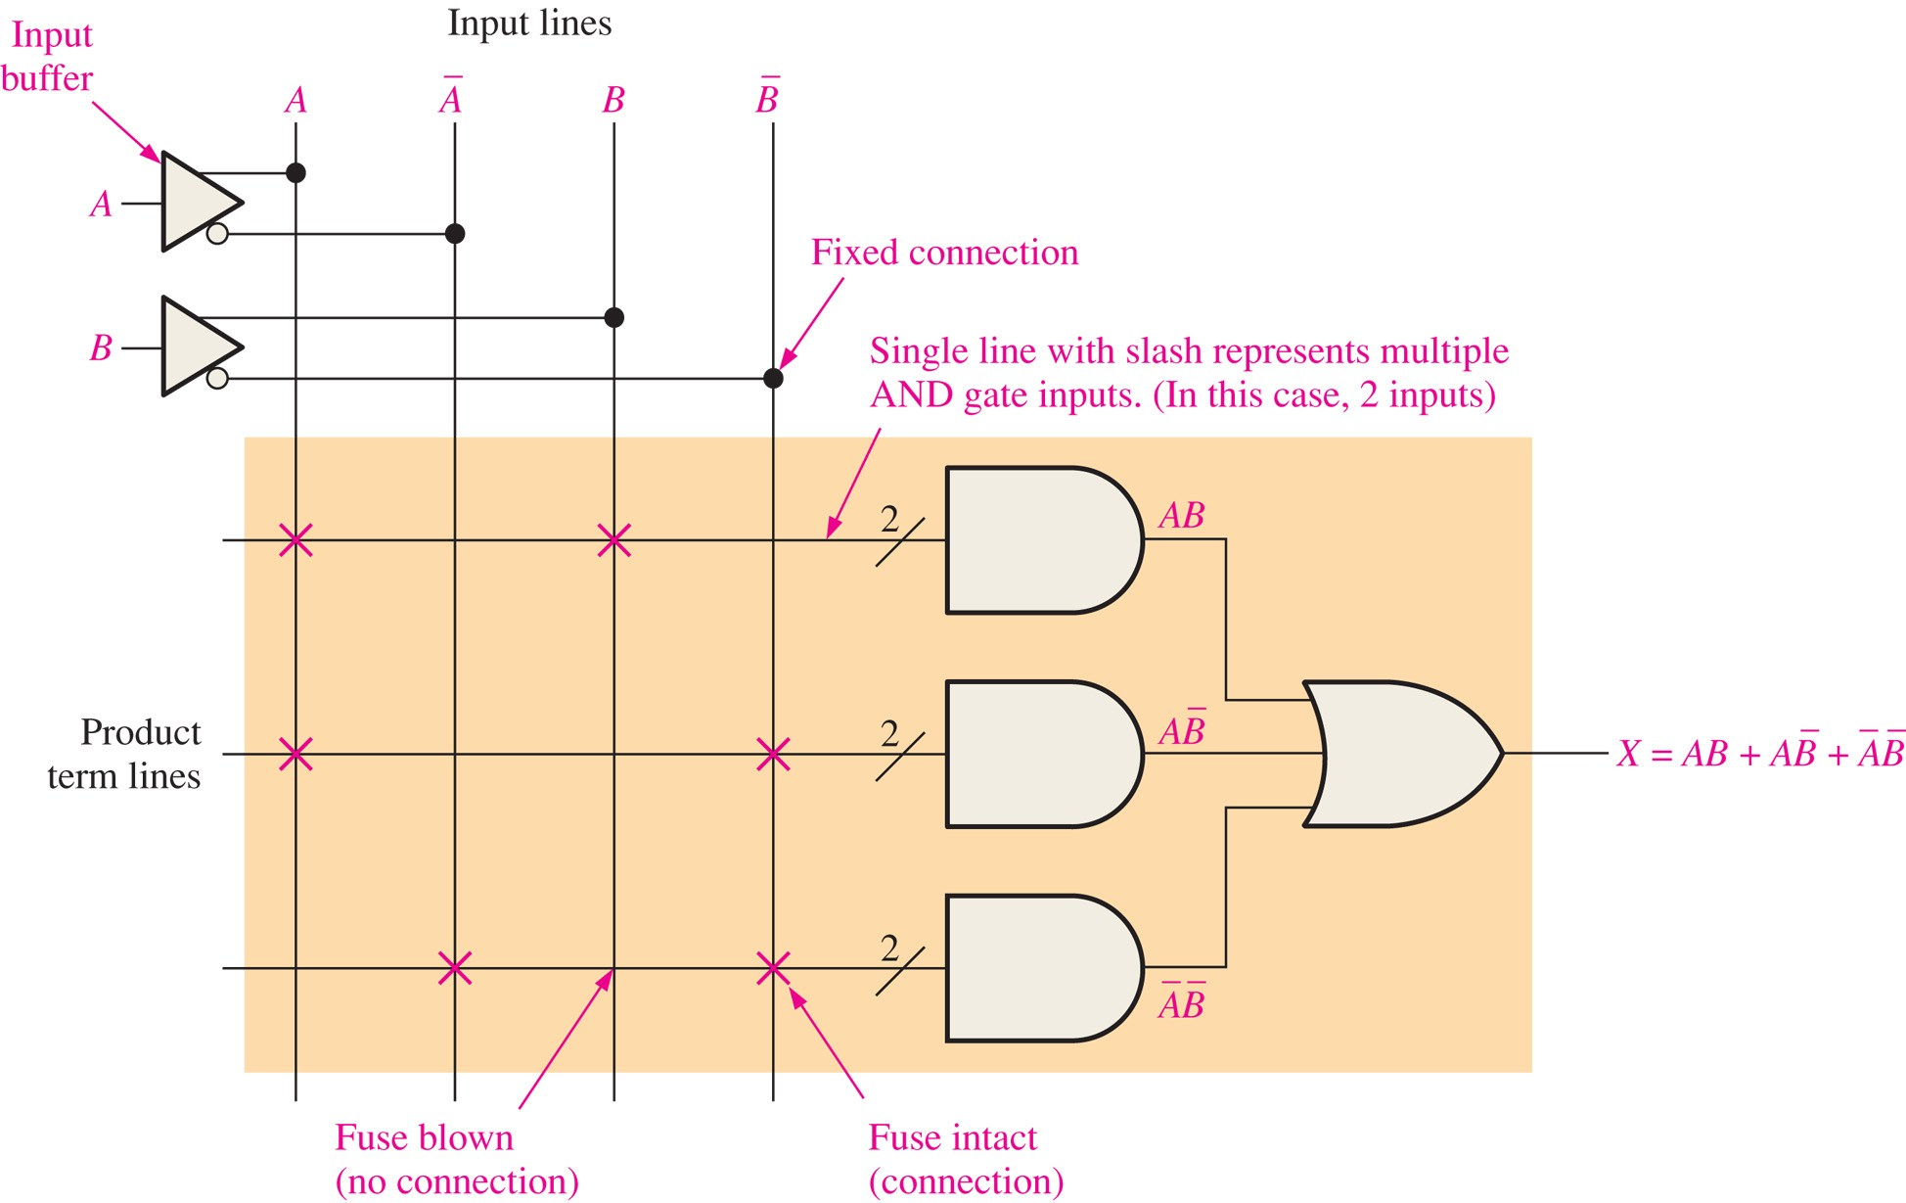
FIGURE 10-4 A portion of a programmed PAL/GAL.

Slide 6
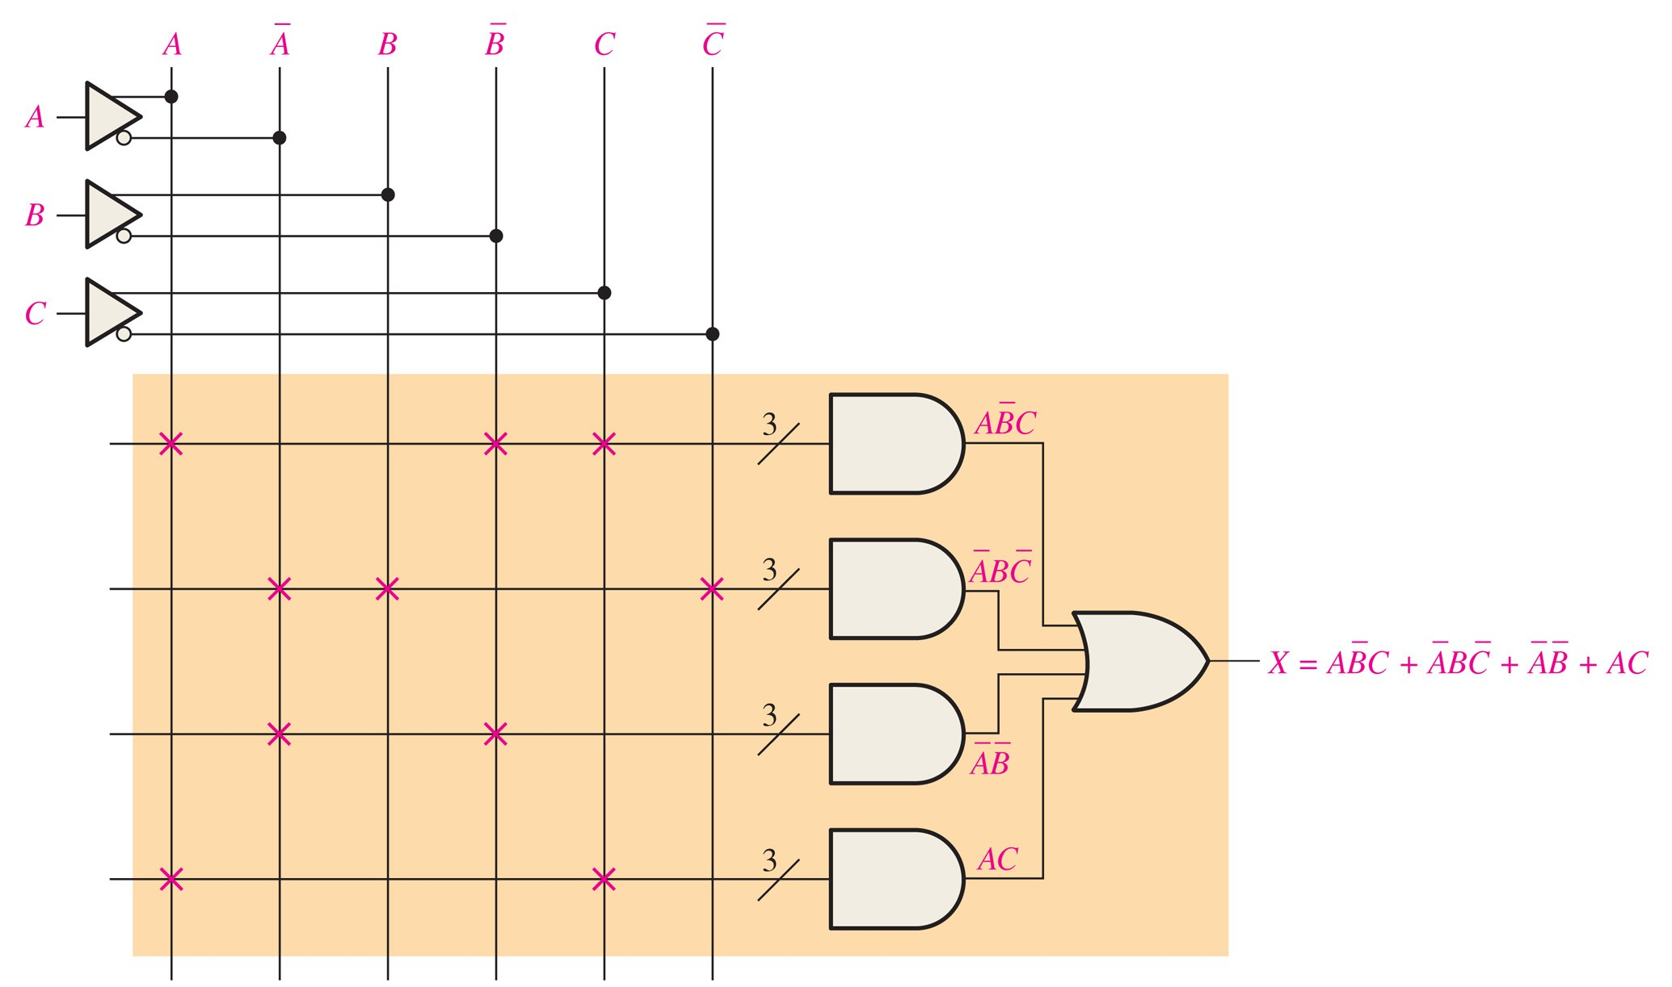
FIGURE 10-5

Slide 7
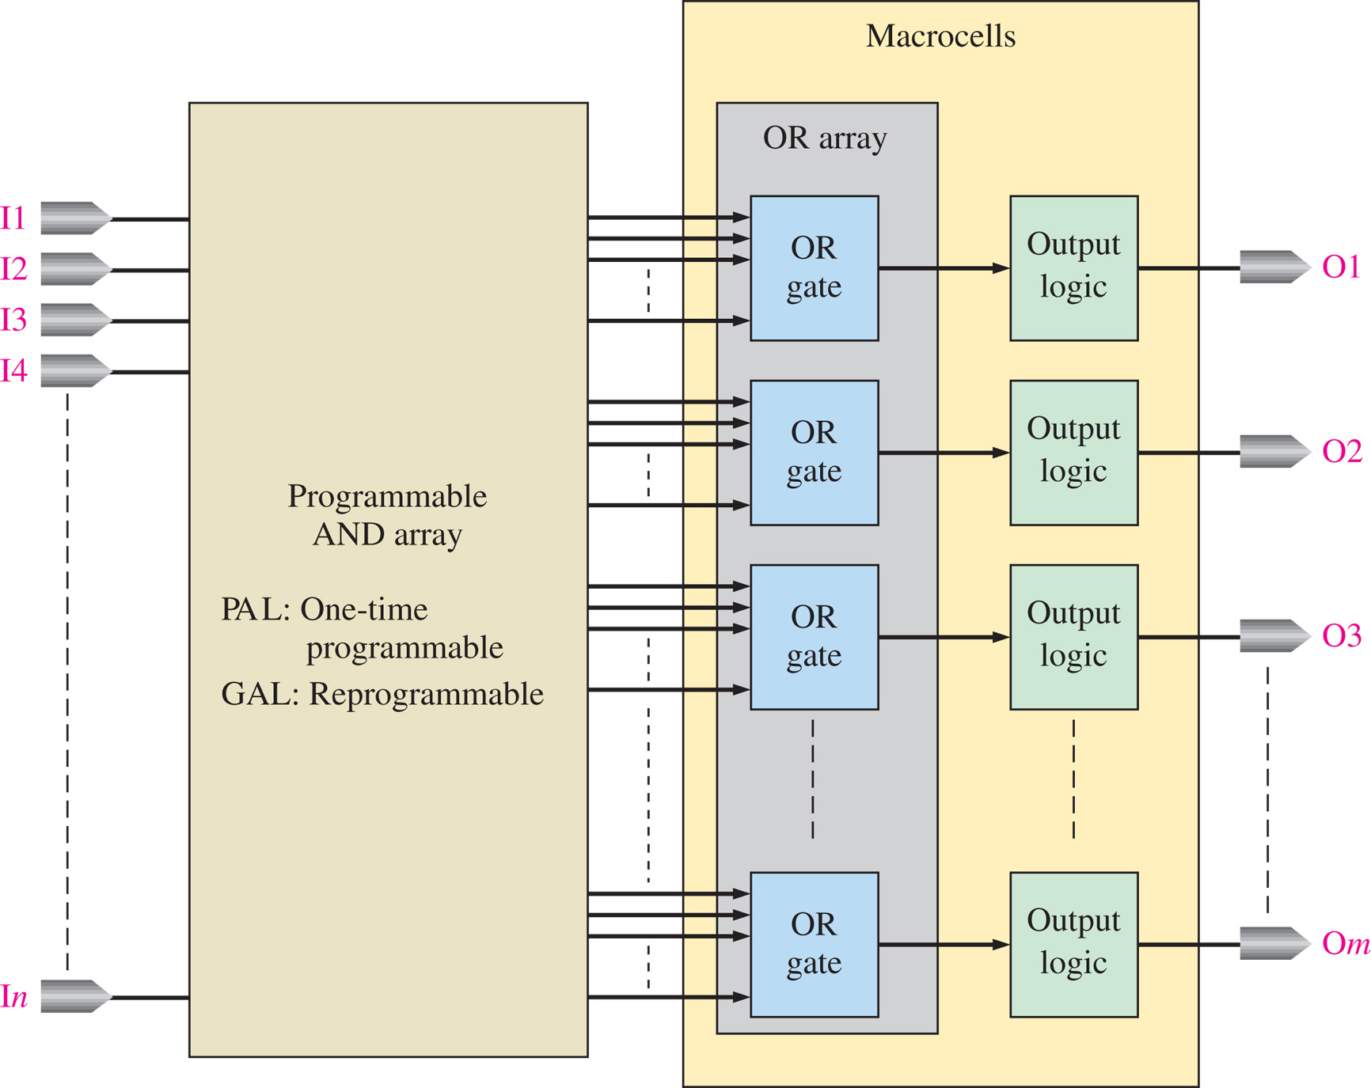
FIGURE 10-6 General block diagram of a PAL or GAL.

Slide 8
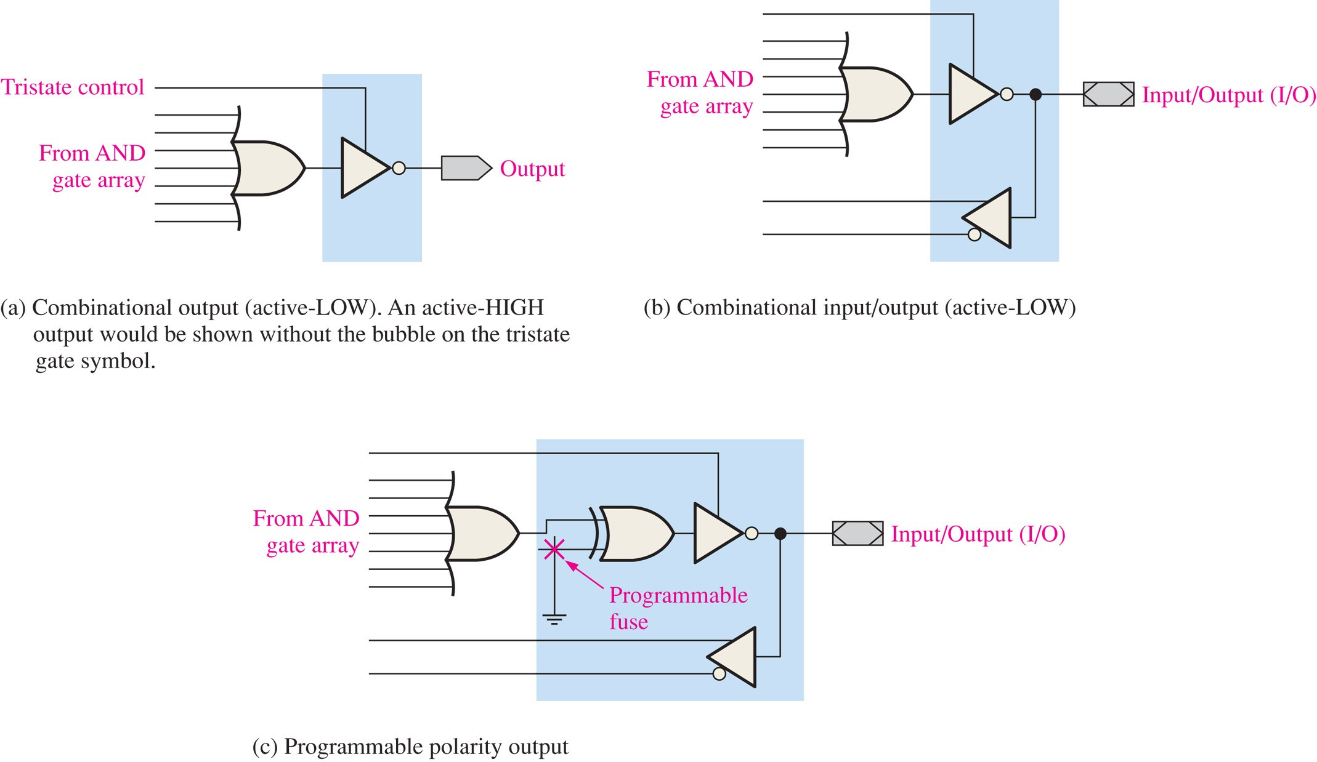
FIGURE 10-7 Basic types of PAL/GAL macrocells for combinational logic.

Slide 9
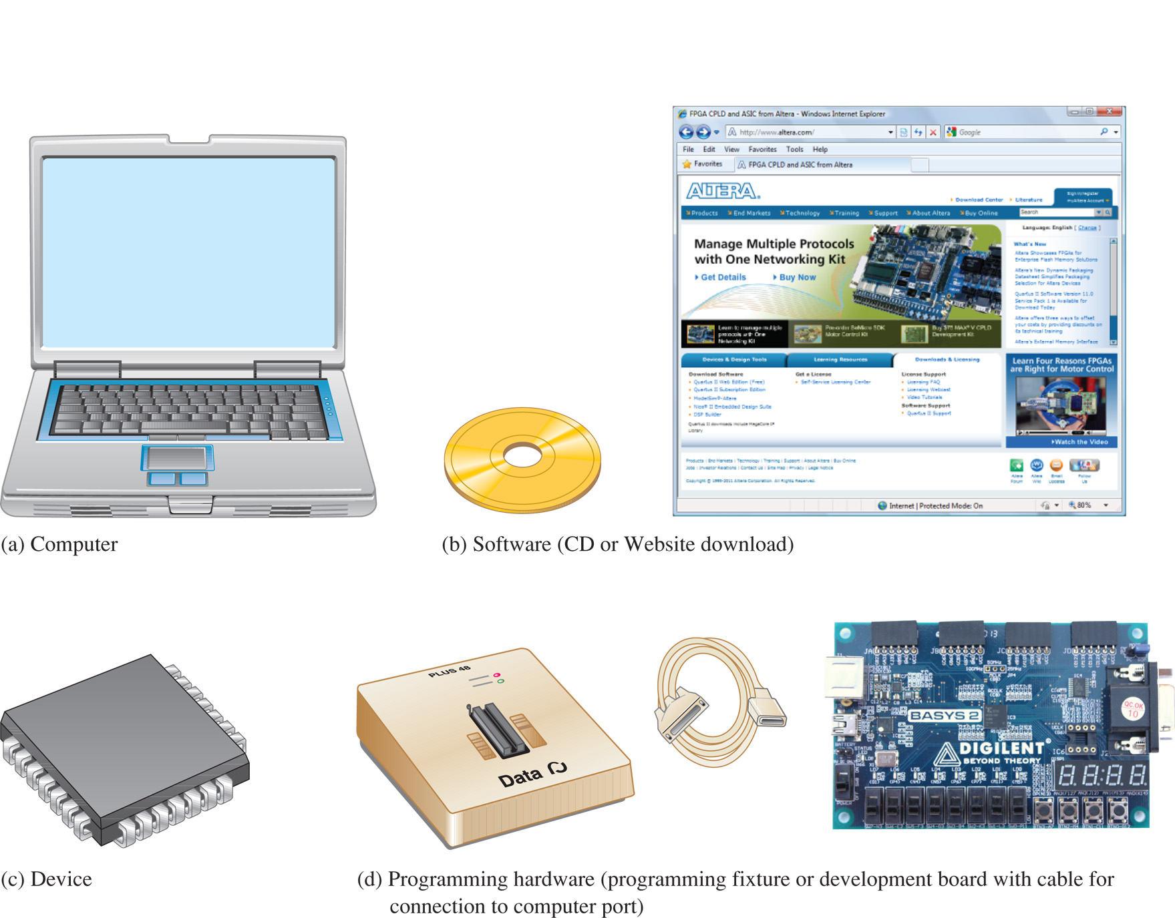
FIGURE 10-35 Essential elements for programming an SPLD, CPLD, or FPGA.
(d) photo courtesy of Digilent, Inc.

Slide 10
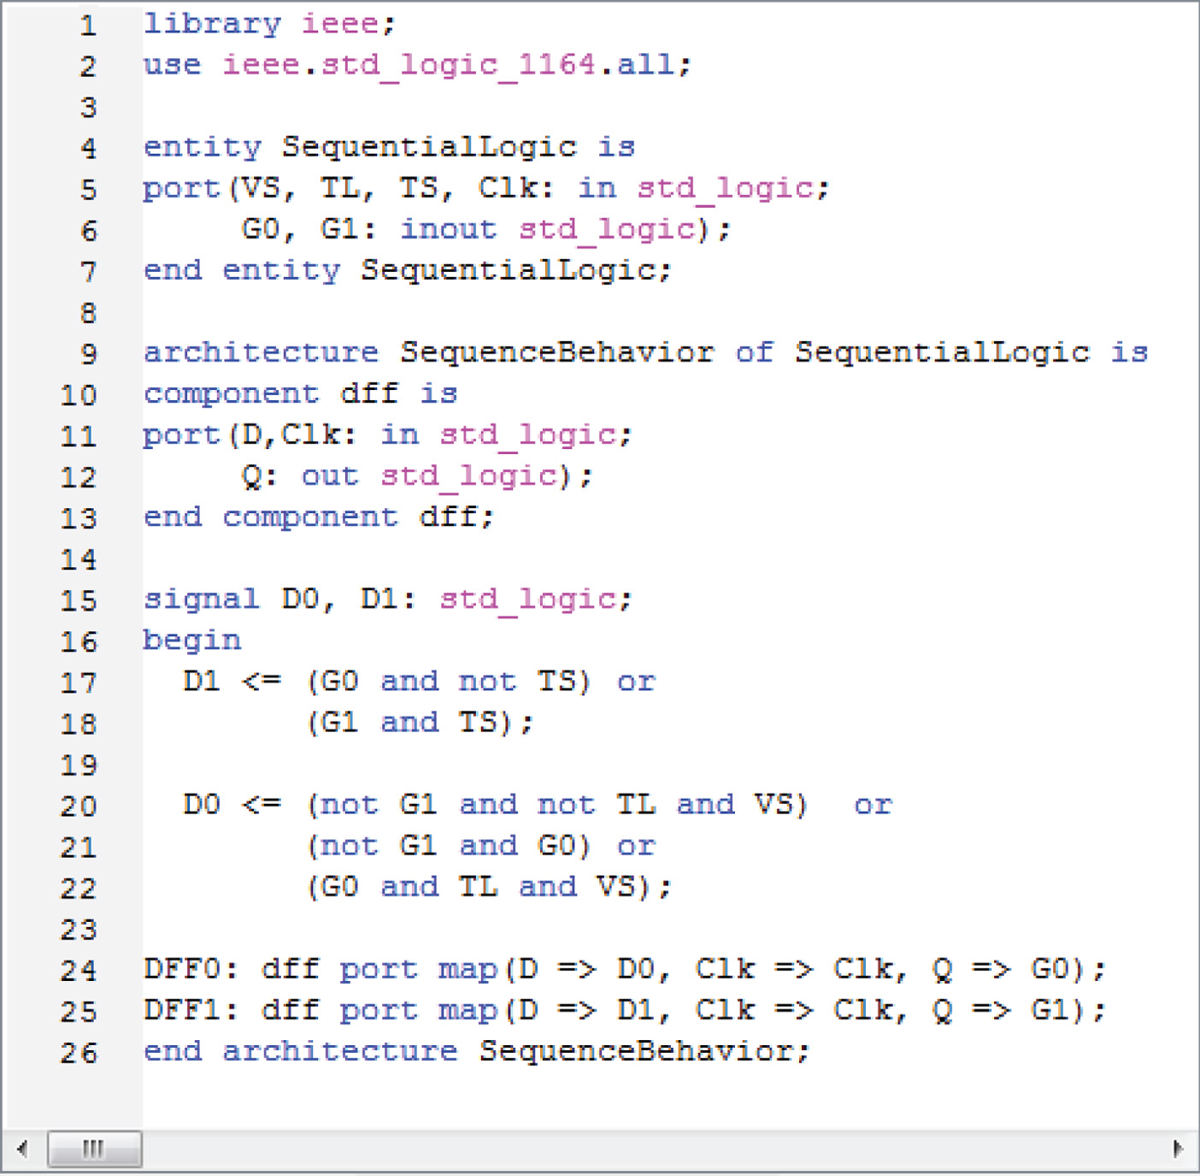
FIGURE 10-37 Text entry with VHDL description of the sequential logic for the traffic signal controller.

Slide 11
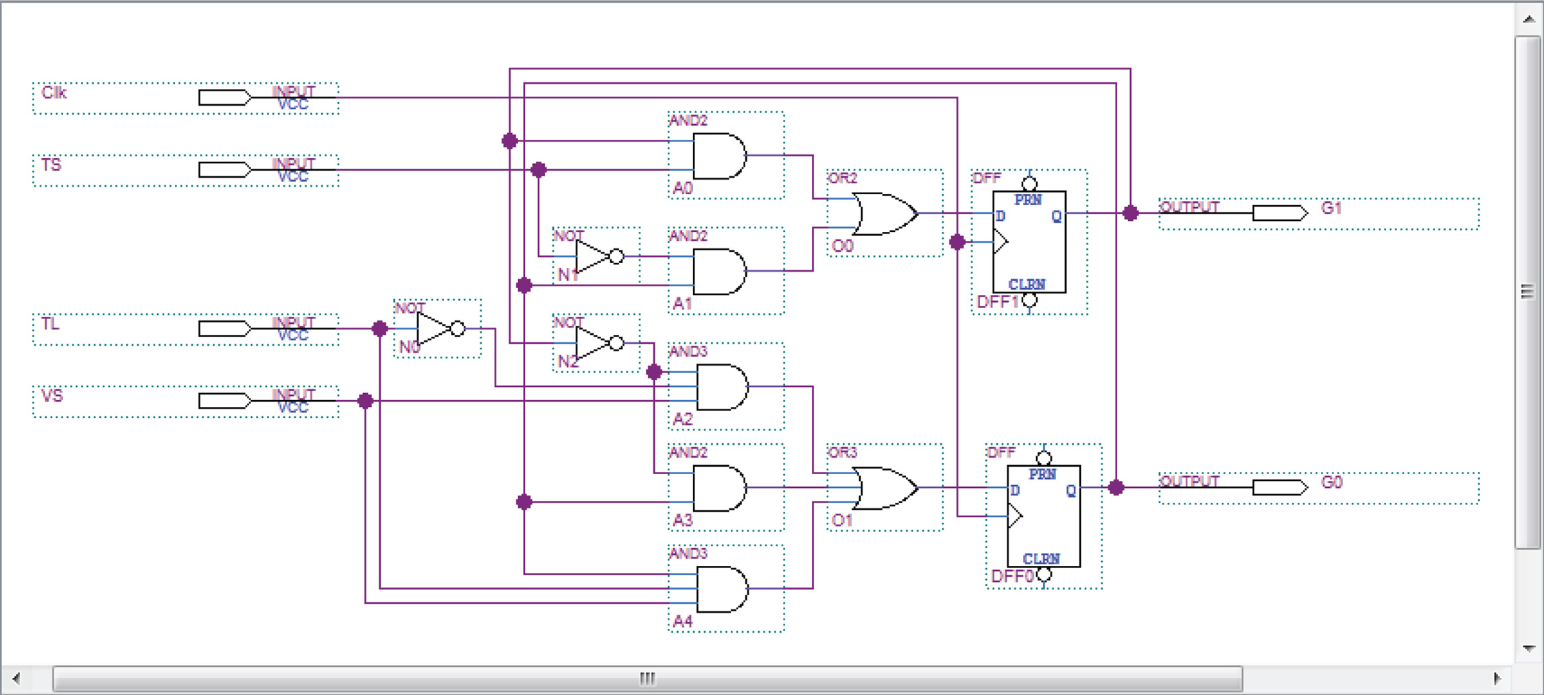
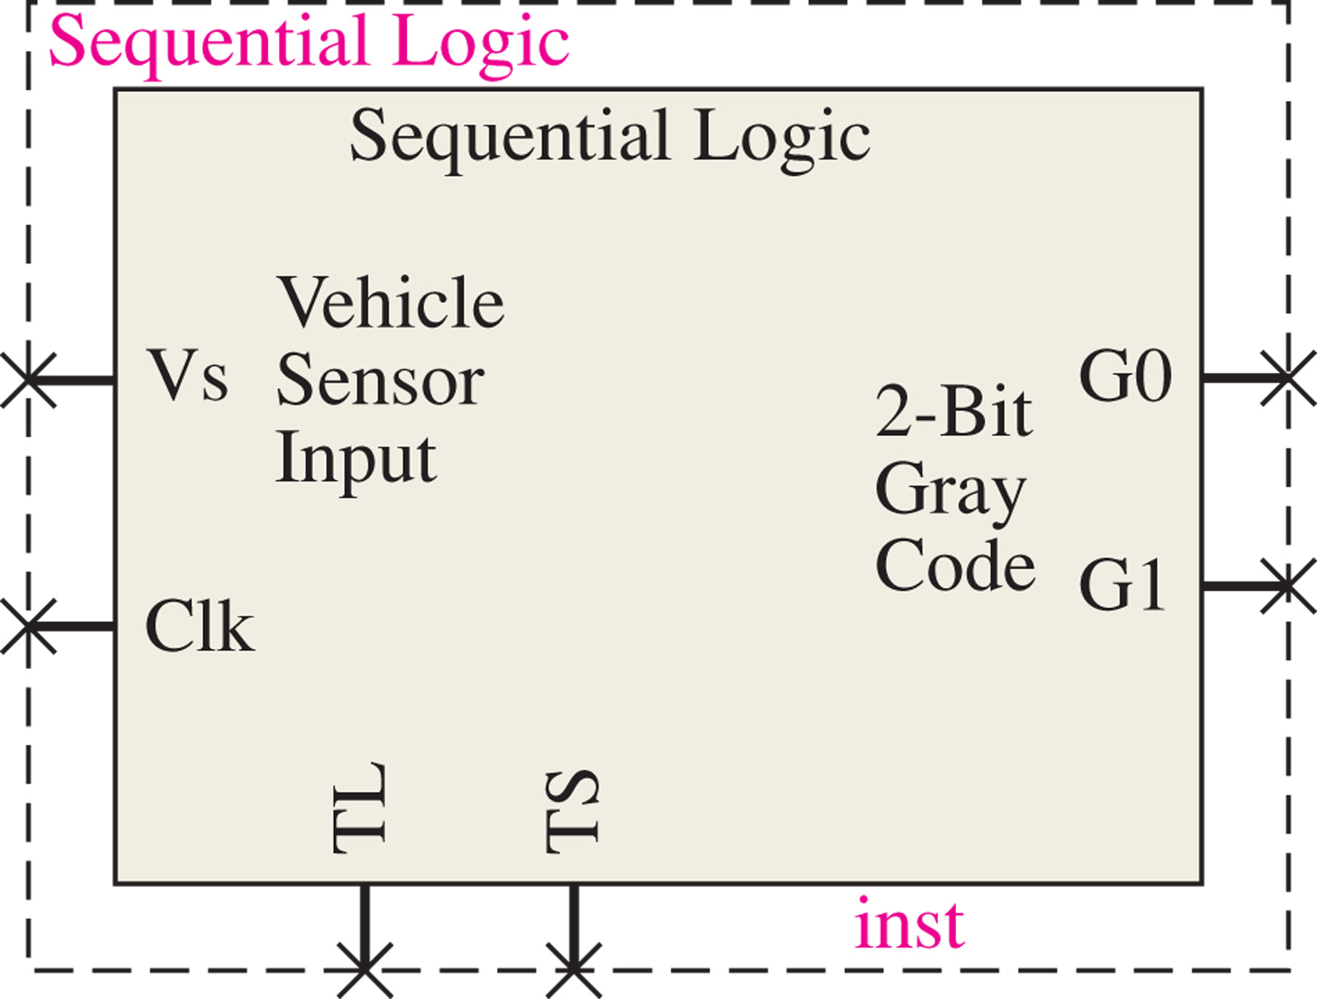
FIGURE 10-38 The sequential logic using schematic entry.

Slide 12
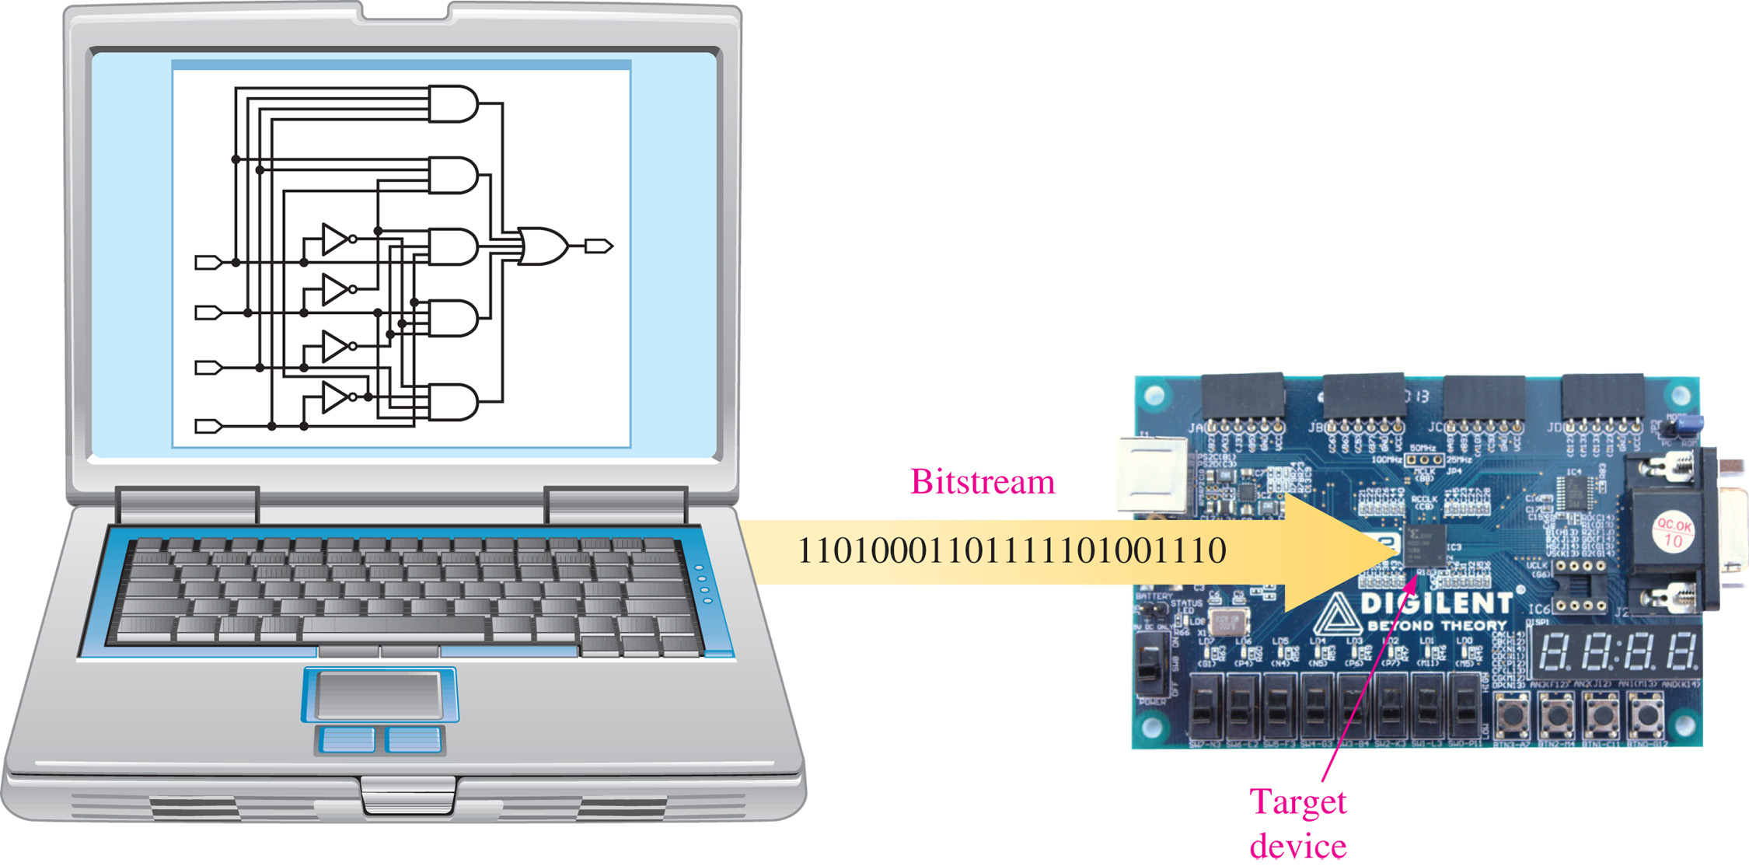
FIGURE 10-44 Downloading a design to the target device.
(Photo courtesy of Digilent, Inc.)

